Slide 1
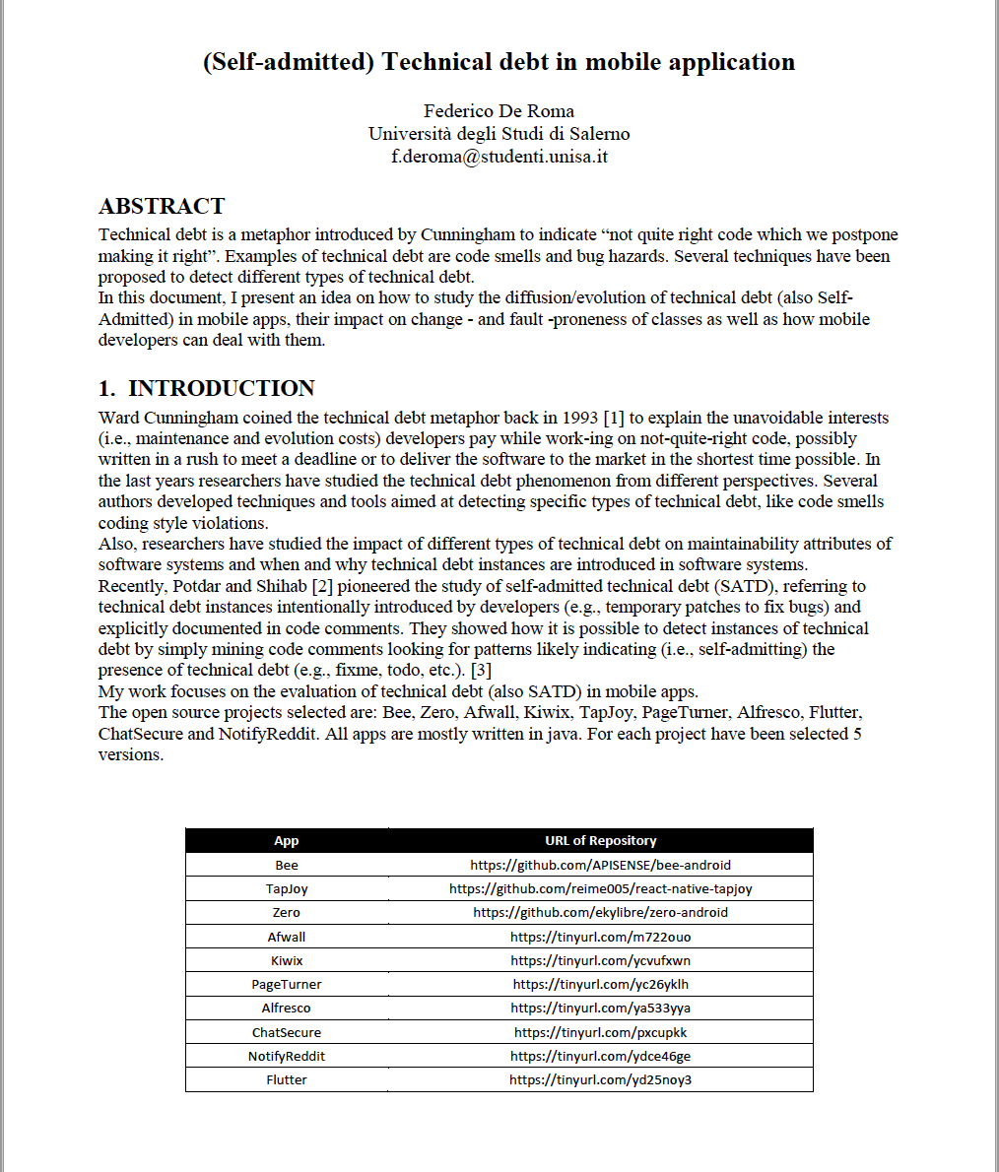



(Self-admitted) Technical debt in mobile applications
SOFTWARE DEPENDABILITY PROJECT
Student:
Federico De Roma
Università degli Studi di Salerno f.deroma@studenti.unisa.it
External Advisor:
Gemma Catolino
Post-doctoral researcher at the Delft
University of Technology, NL
g.catolino@tudelft.nl

Slide 2
CONTEXT OF THE PROJECT
Technical debt is a metaphor introduced by Cunningham to indicate “not quite right code which we postpone making it right”.
Examples of technical debt are code smells and bug hazards.
Ward Cunningham coined the technical debt metaphor back in 1993 to explain the unavoidable interests (i.e., maintenance and evolution costs) developers pay while work-ing on not-quite-right code, possibly written in a rush to meet a deadline or to deliver the software to the market in the shortest time possible.
Recently, Potdar and Shihab pioneered the study of self-admitted technical debt (SATD), referring to technical debt instances intentionally introduced by developers (e.g., temporary patches to fix bugs) and explicitly documented in code comments.
They showed how it is possible to detect instances of technical debt by simply mining code comments looking for patterns likely indicating (i.e., self-admitting) the presence of technical debt (e.g., fixme, todo, etc.).

Slide 3

CONTEXT OF THE PROJECT
Several authors developed techniques and tools aimed at detecting specific types of technical debt, like code smells coding style violations.
But little is know in known in the context of mobile application.

Slide 4
goals OF THE PROJECT
The main goals of the project are:
To define a correct way to estimate the technical debt (also SATD) in the selected open source project.
To know how the technical debt has been threated – if it has been removed, how and when.
To explain the differences between the handle of technical debt in traditional application and the handle of technical debt in mobile application.

Slide 5
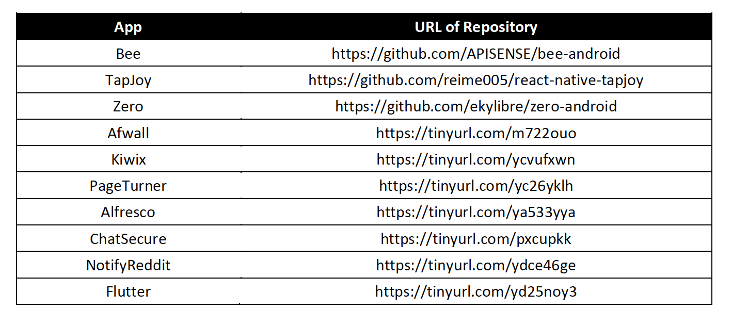
METHODOLOGY
The open source projects selected are: Bee, Zero, Afwall, Kiwix, TapJoy, PageTurner, Alfresco, Flutter, ChatSecure and NotifyReddit. All apps are mostly written in java. For each project have been selected 5 versions.
The analysis consists of the following 4 steps:
Technical Debt Estimation
Self Admitted Technical Debt (SATD) Estimation
Change Proneness Estimation
Fault Proneness Estimation

Slide 6
Technical debt estimation
In order to extract technical debt, I used SonarQube, an open source platform developed by SonarSource for continuous code quality inspection, to perform automatic reviews with static code analysis.
After cloning the app from GitHub, I ran SonarQube launching it from the console, reporting the location of the app folder.
After that, I modified the file “sonar-project.properties” and I started Sonar Scanner.

Slide 7
Technical debt estimation

Slide 8
Technical debt estimation

Slide 9
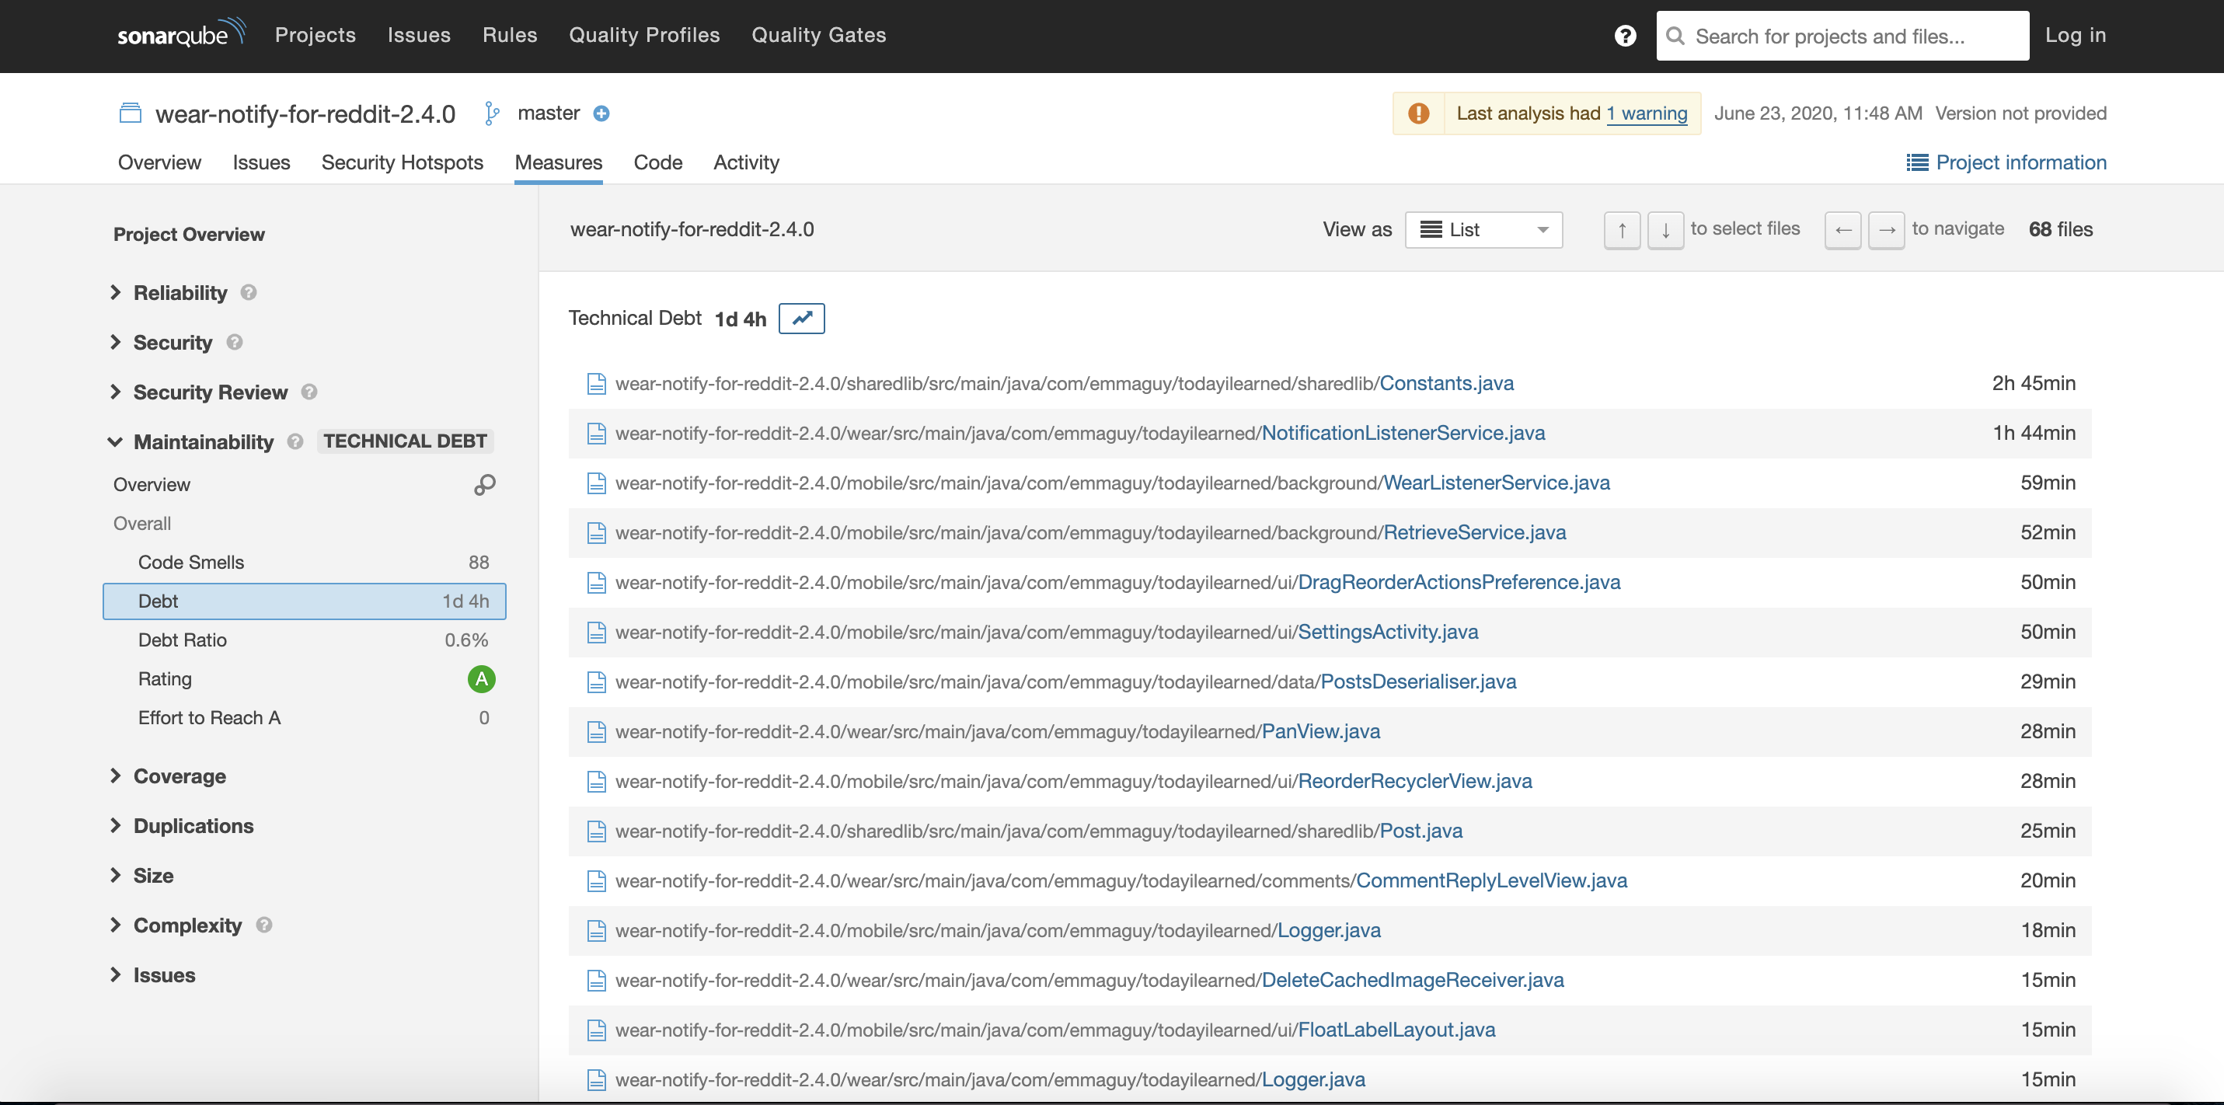
Technical debt estimation
An example of results obtained:

Slide 10
SATD estimation
To analyze the SATDs (Self Admitted Technical Debts), I used the approach describe by S. Maldonado, Emad Shihab and Nikolaos Tsantalis.
This approach consists of the following steps:
Extract the source code comments from the projects.
Apply five filtering heuristics to remove comments that result irrelevant for the identification of SATD (e.g., license comments, commented source code).
In order to do the first step, I opened the project from Eclipse and I extracted all the source code comments from the app.
To remove the comments that result irrelevant for the estimation of SATD, I used a tool able to filter only the comments that were useful for the estimation of them, implemented by E. Shibab et al..
This tool is an Eclipse plug-in downloadable from here: https://goo.gl/ZzjBzp
This plug-in is able to identify the comments that contain one of task-reserved words (e.g., “todo”, “fixme”, or “xxx”).

Slide 11
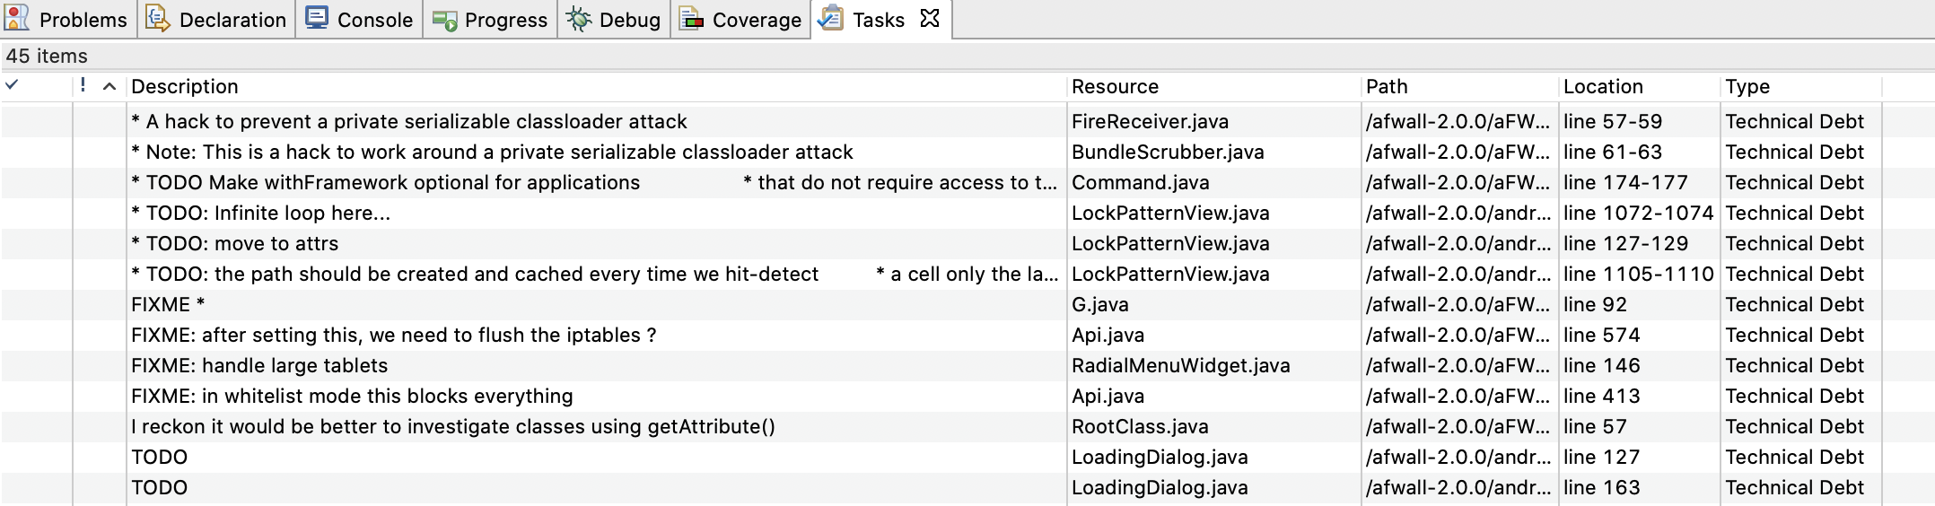
SATD estimation
An example of results obtained:

Slide 12
CHANGE PRONENESS estimation
Change proneness is a quality characteristic of software artifacts that represents their probability to change in the future due to: (a) evolving requirements, (b) bug fixing, or (c) ripple effects.
In the literature, change proneness has been associated with many negative consequences along software evolution.
The third step of this analysis consisted of analyzing the change proneness of the app.
To accomplish this, I used a tool made by N. Tsantalis et al..
This tool is able to calculate the probability of a class to change (from 0 to 1).

Slide 13
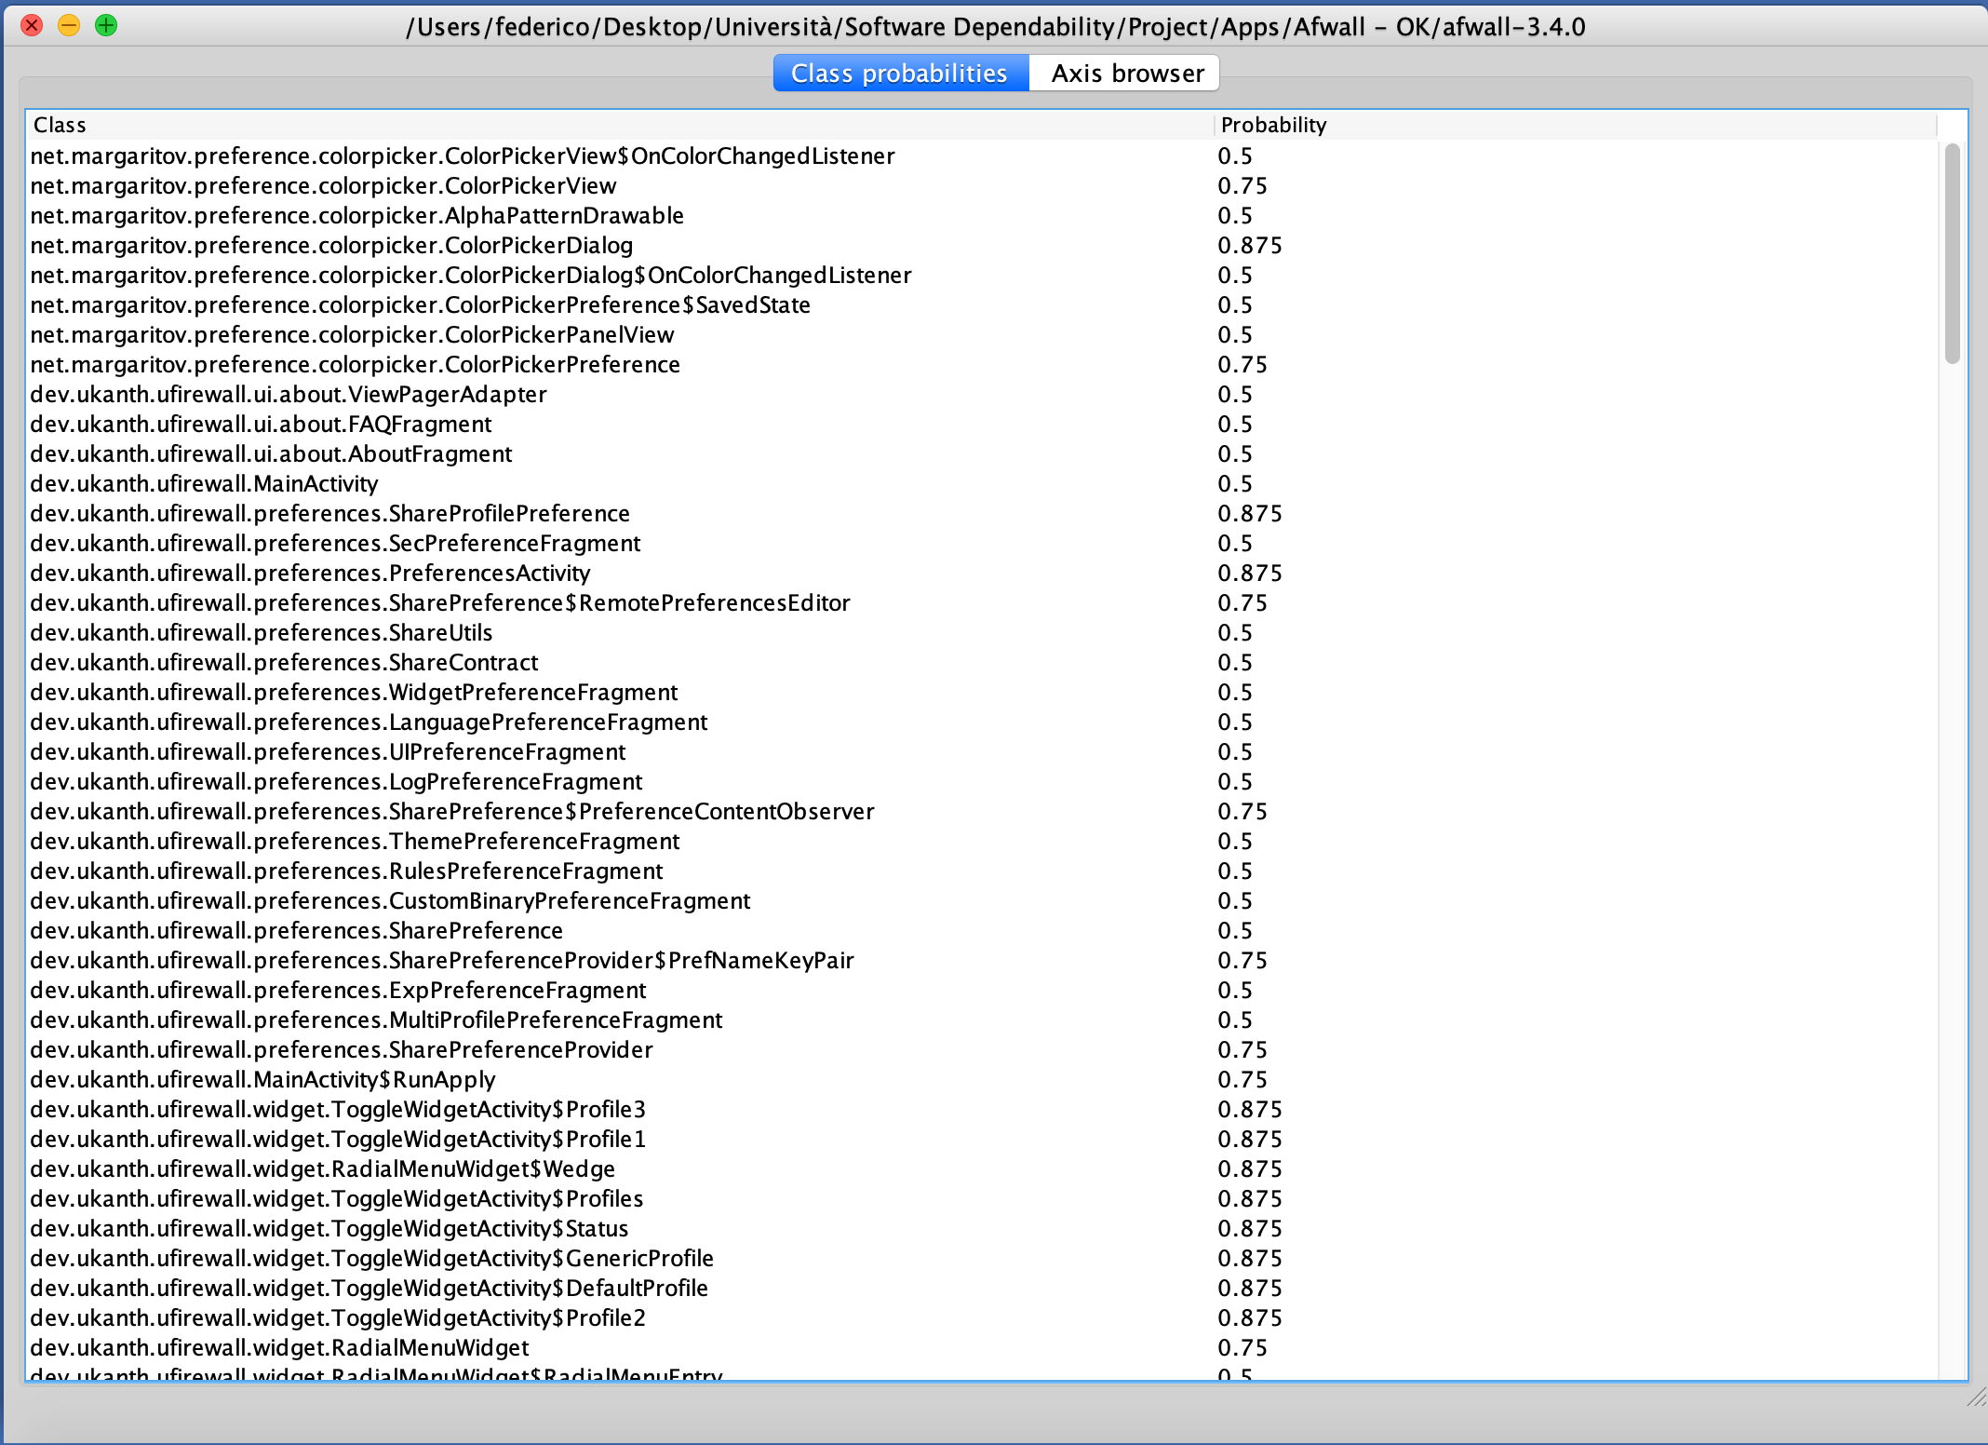
CHANGE PRONENESS estimation
An example of results obtained:

Slide 14
FAULT PRONENESS estimation
Fault proneness is sometimes defined as the probability that an artifact contains a fault.
To measure the fault prone, I followed these steps:
I analyzed the commit messages of the app using PyDriller, that is a Python framework that helps developers in analyzing Git repositories. So, it is relatively easy extract information such as commits, developers, modifications, diffs, and source codes.
I counted the number of fixing operations for each version of the project.

Slide 15
RESULTS AND FINDINGS
I extended the analysis to 9 other apps.
For each app, I made 4 tables, one for each element (TD, SATD, change proneness, fault proneness), and 3 plot.

Slide 16
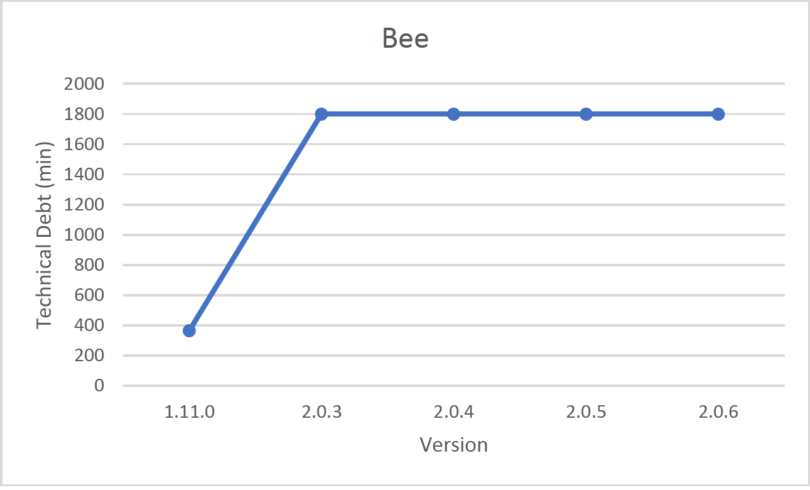
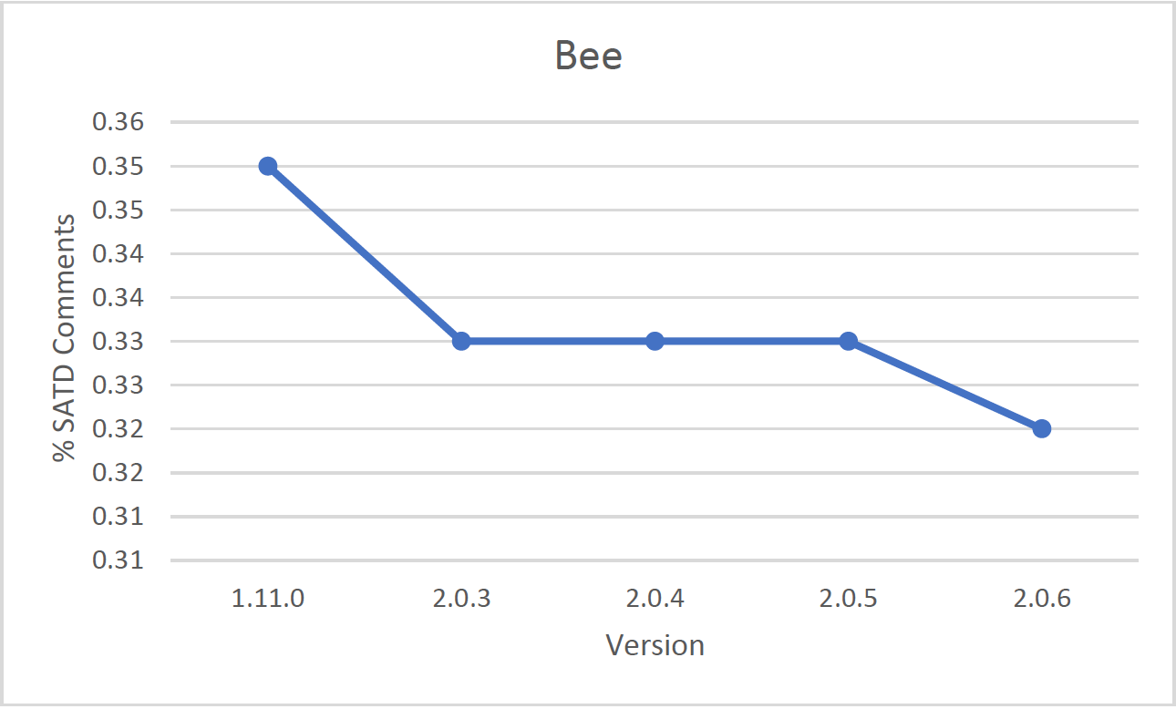
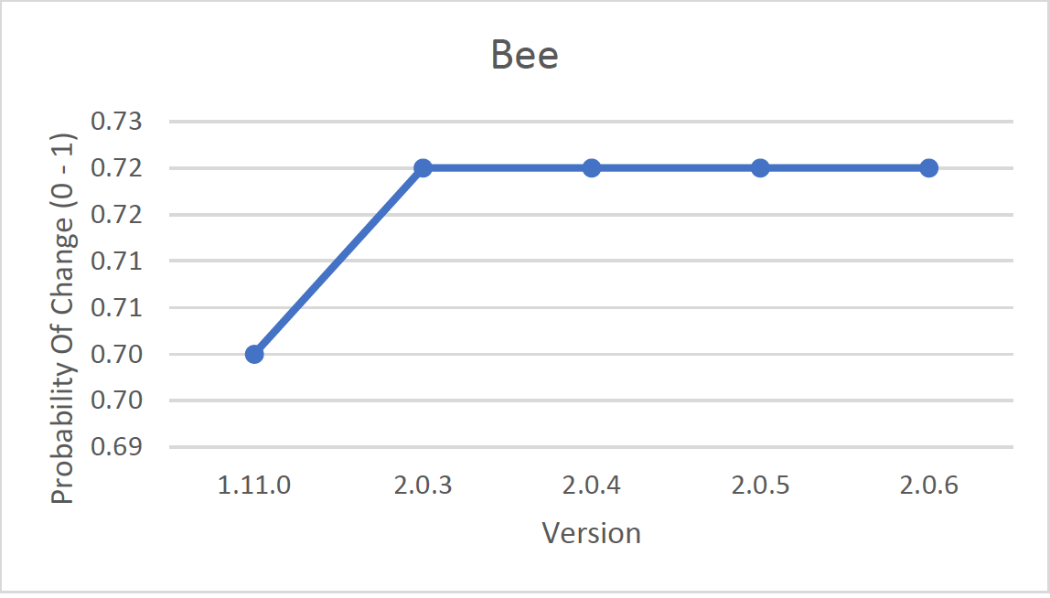
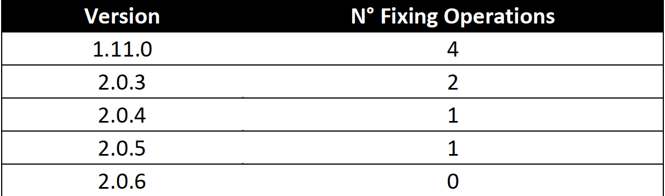
BEE

Slide 17
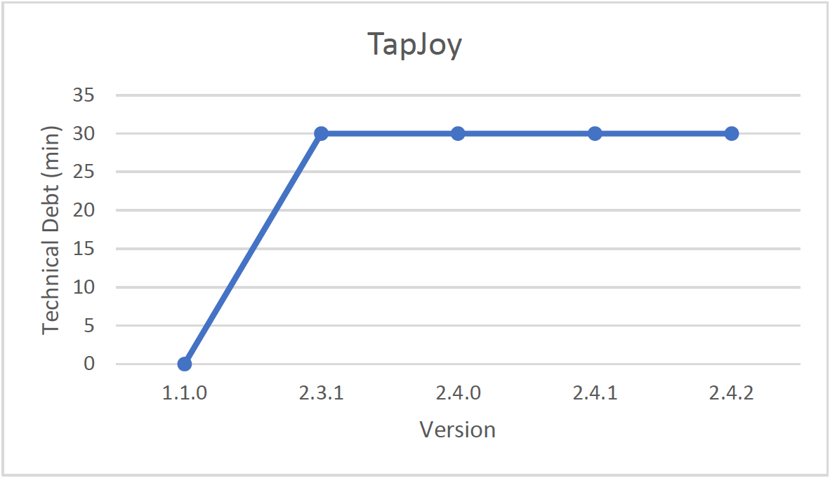
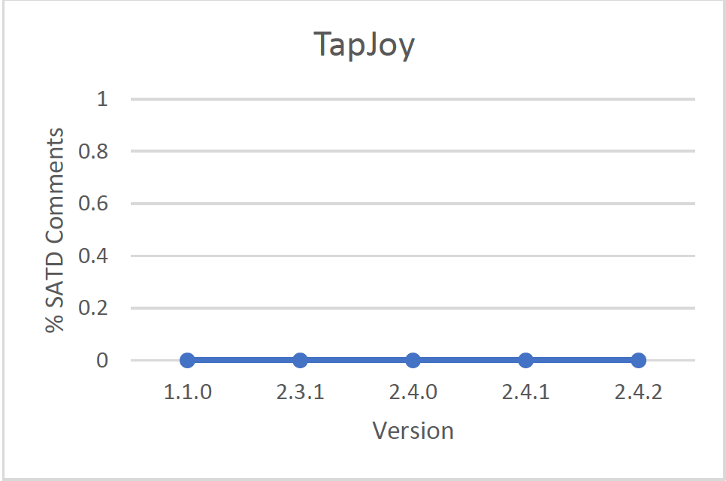
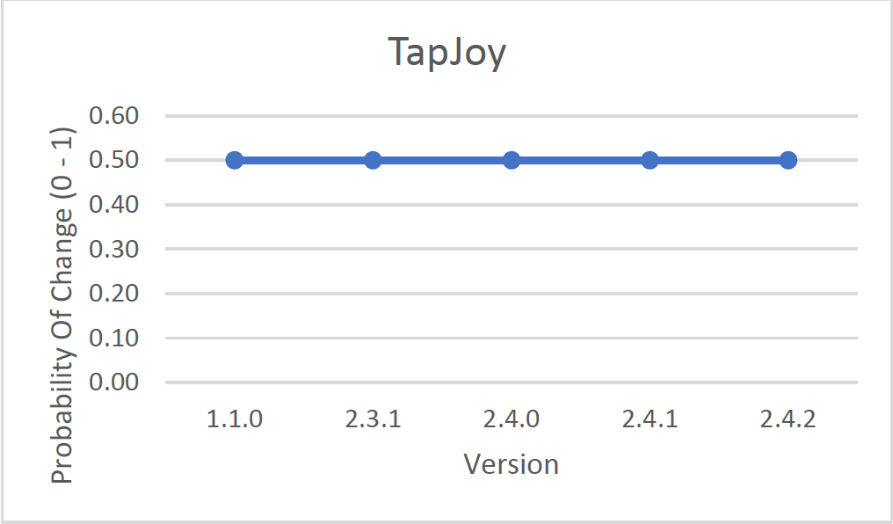
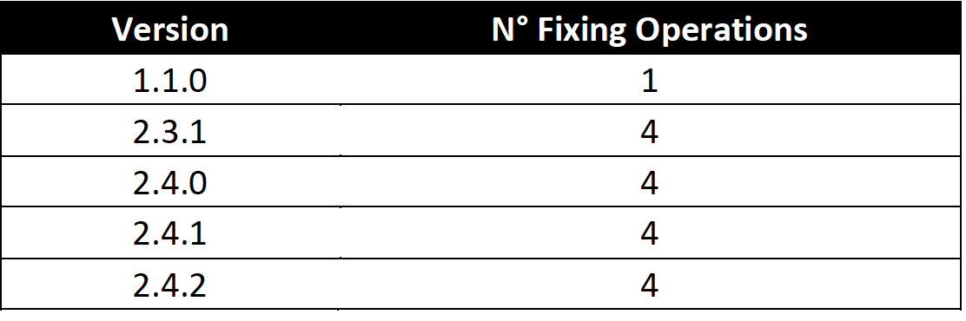
tapjoy

Slide 18
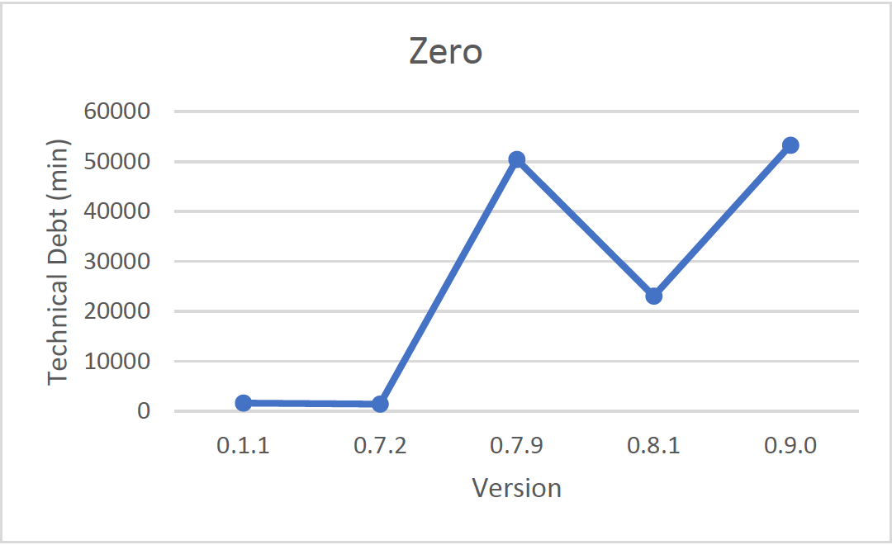
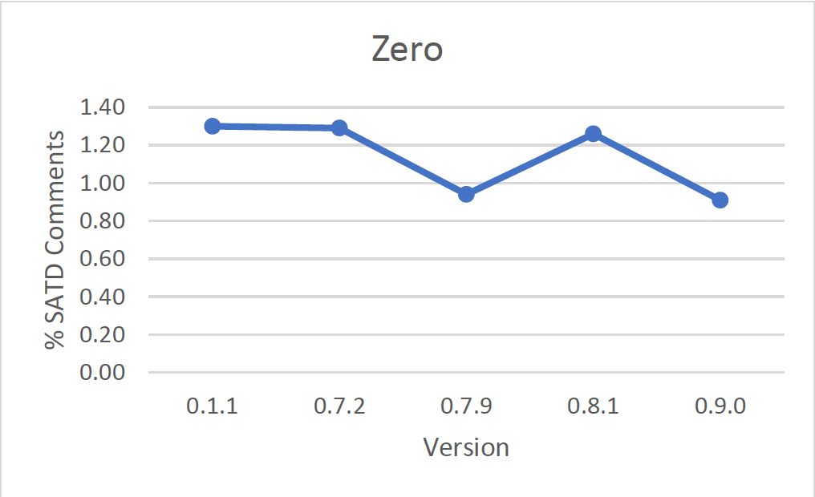
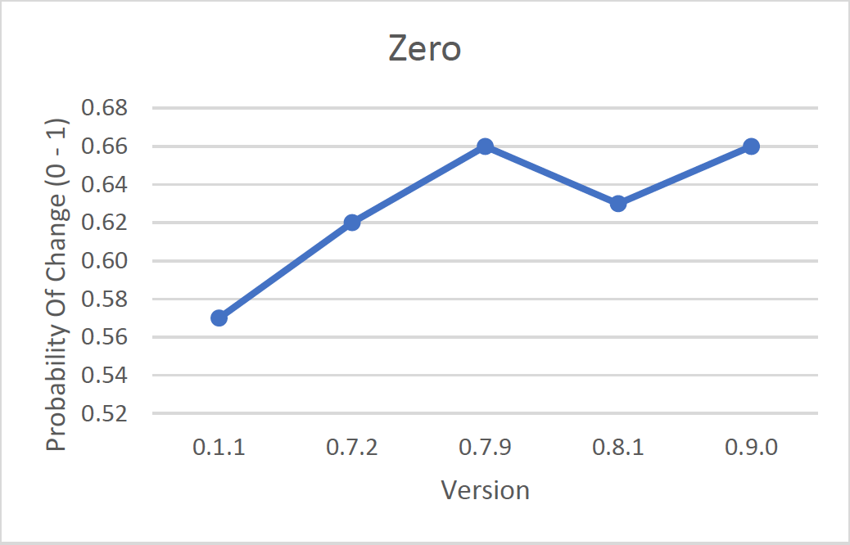
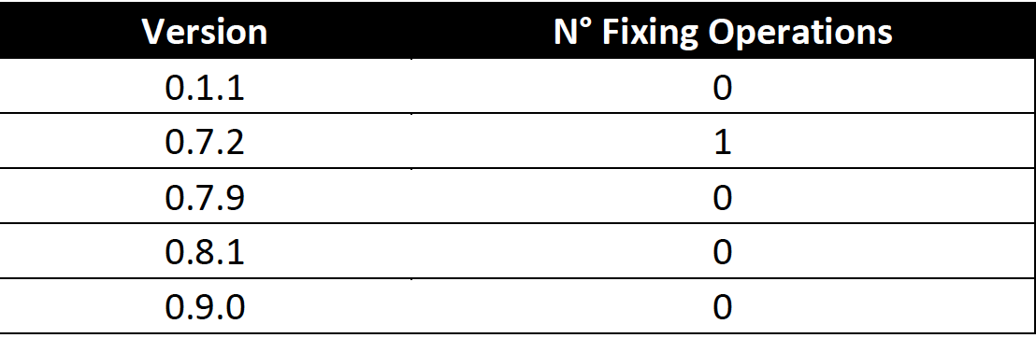
ZERO

Slide 19
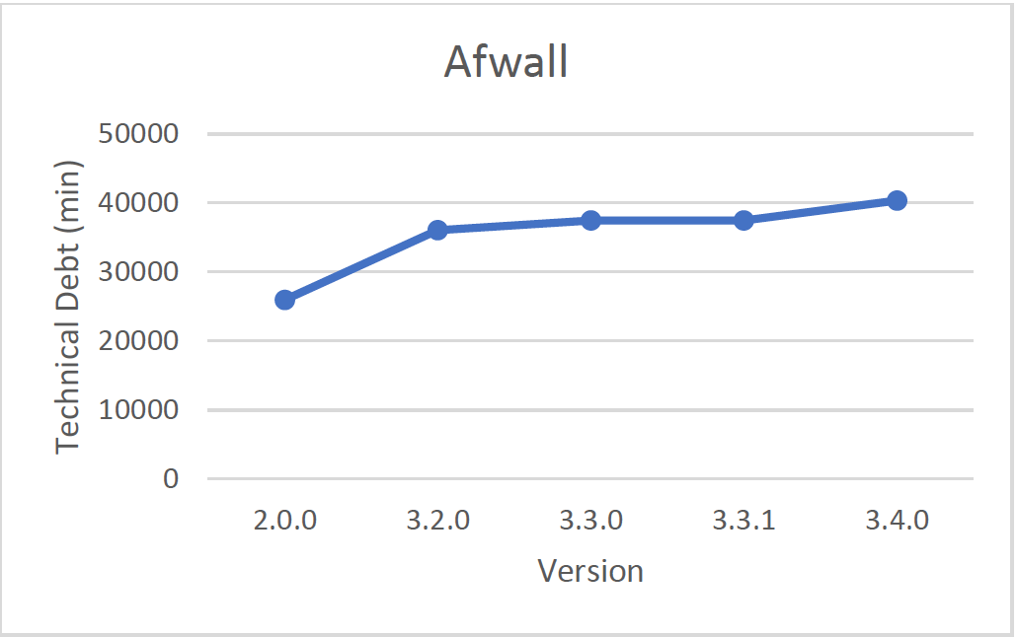
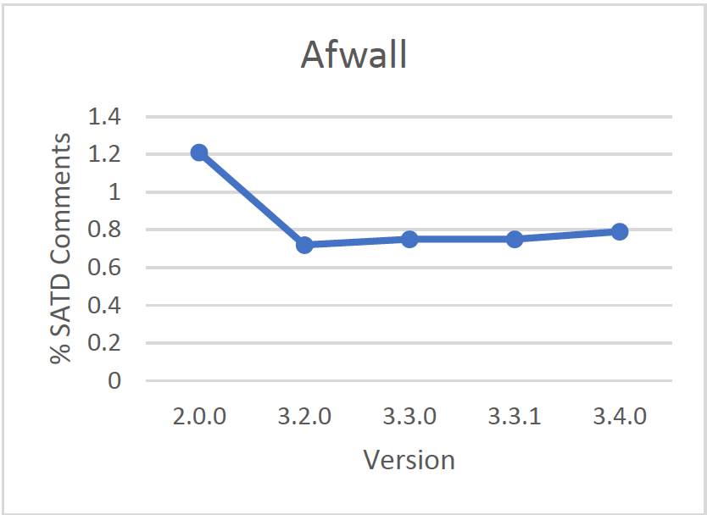
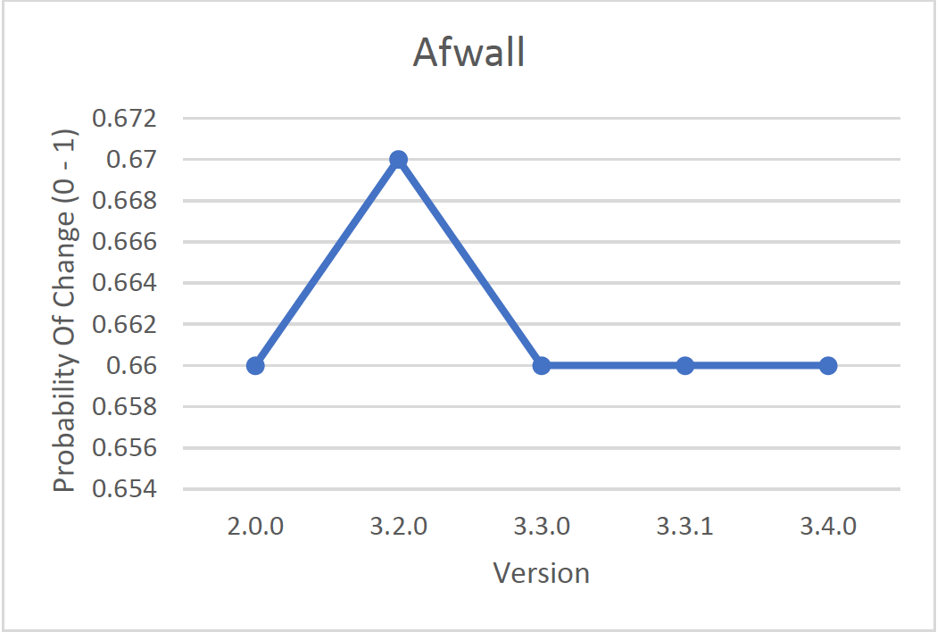
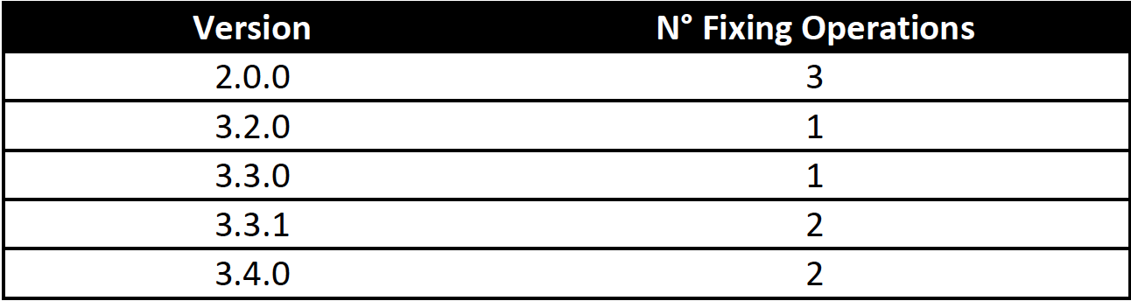
AFWALL

Slide 20
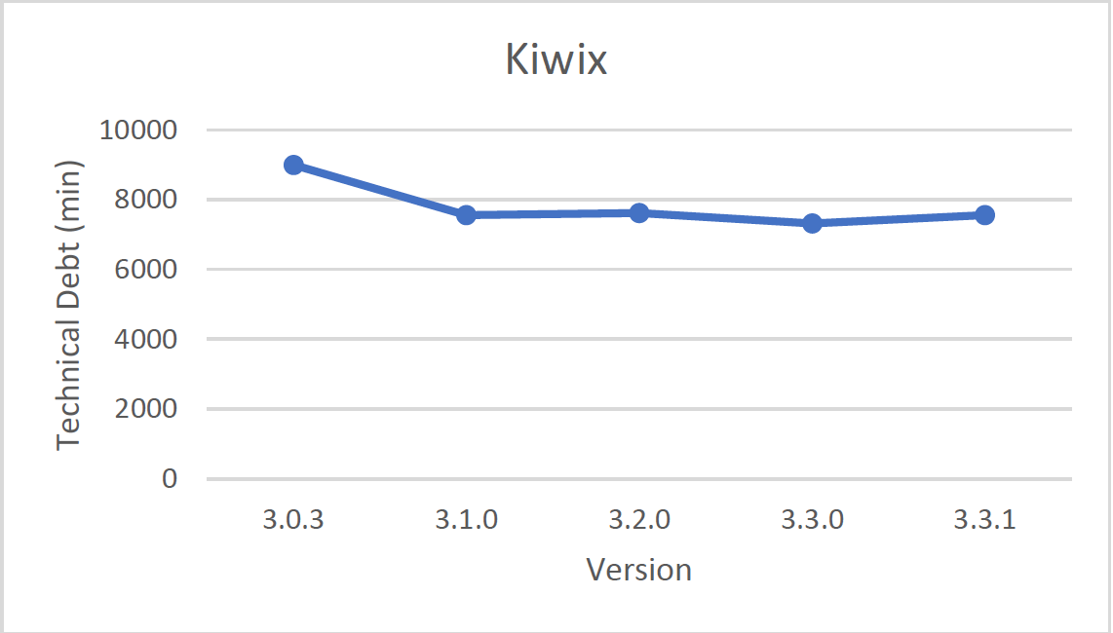
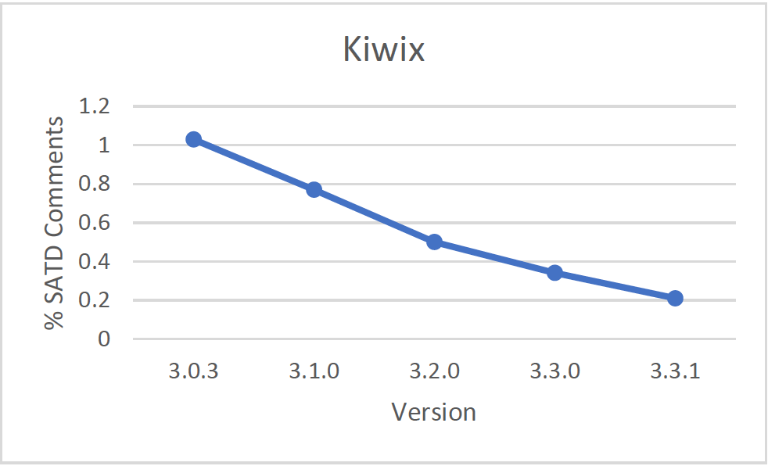
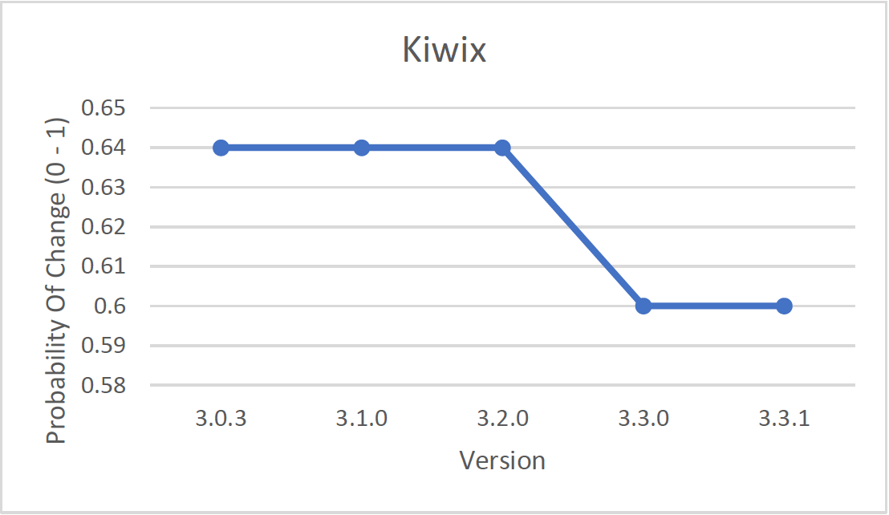
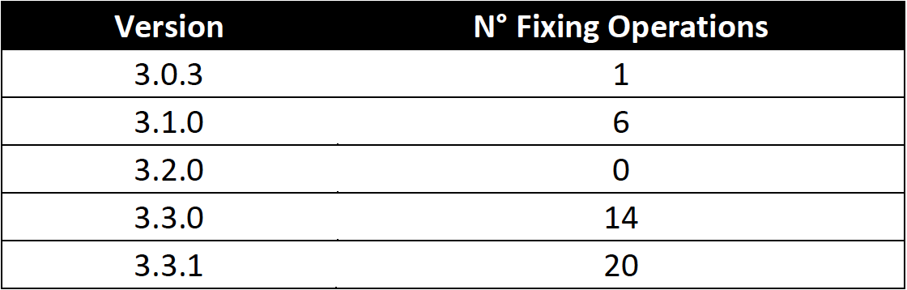
kiwix

Slide 21
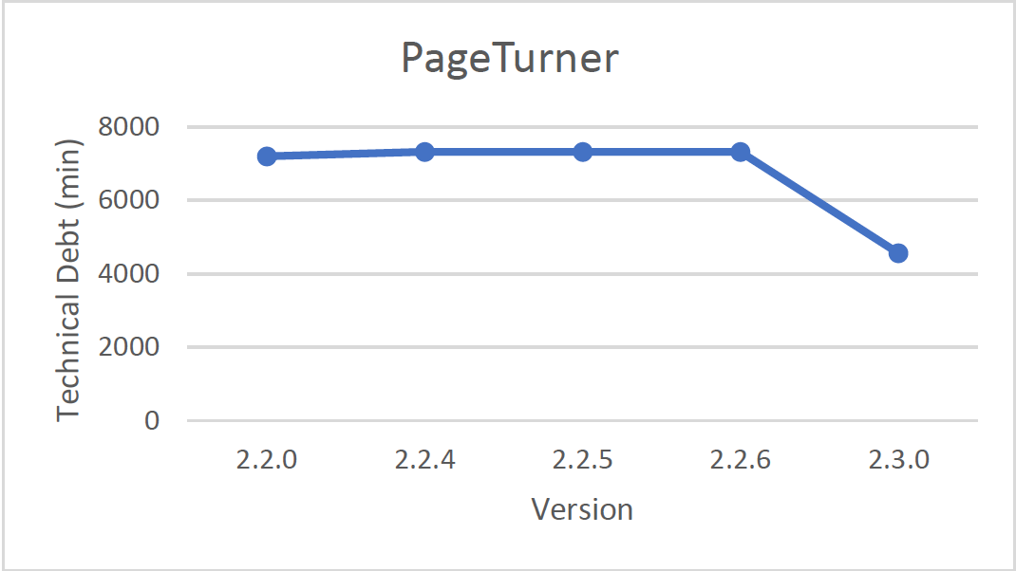
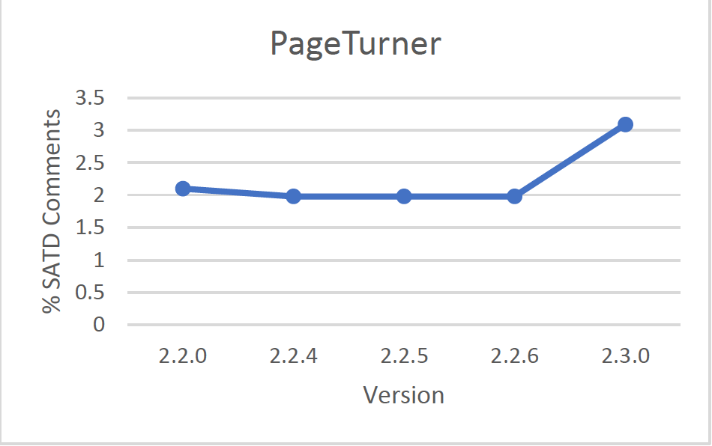
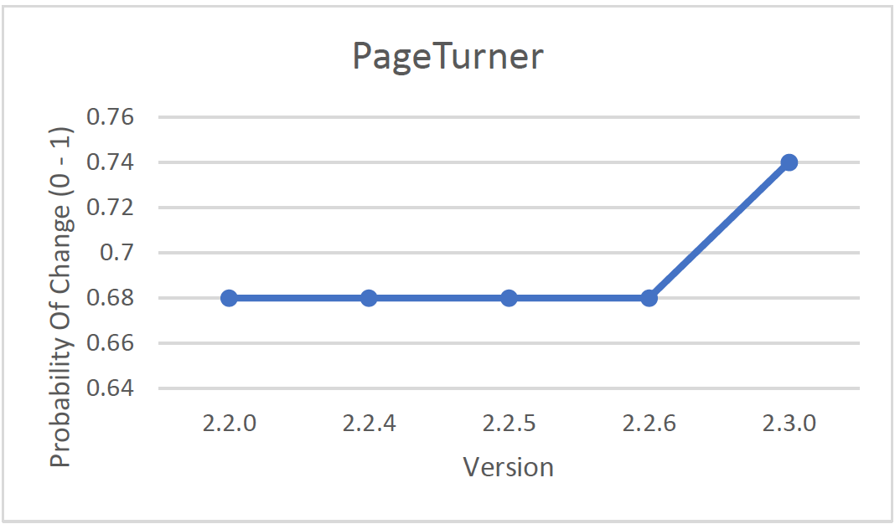
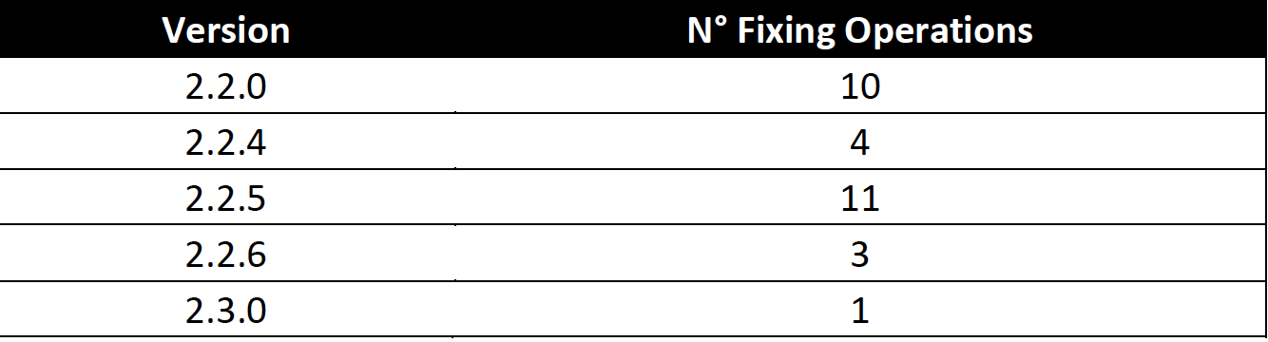
PAGETURNER

Slide 22
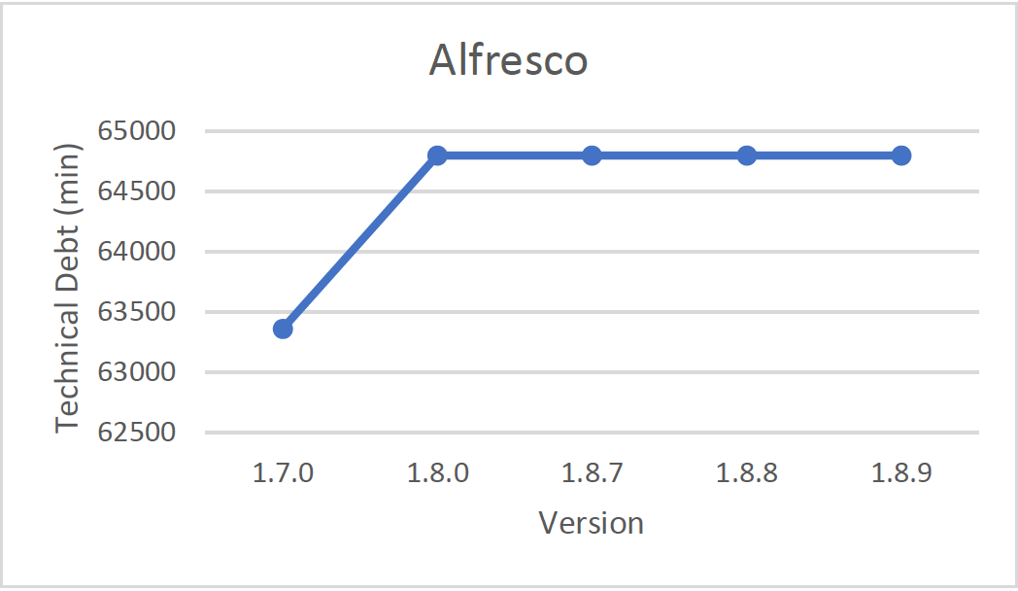
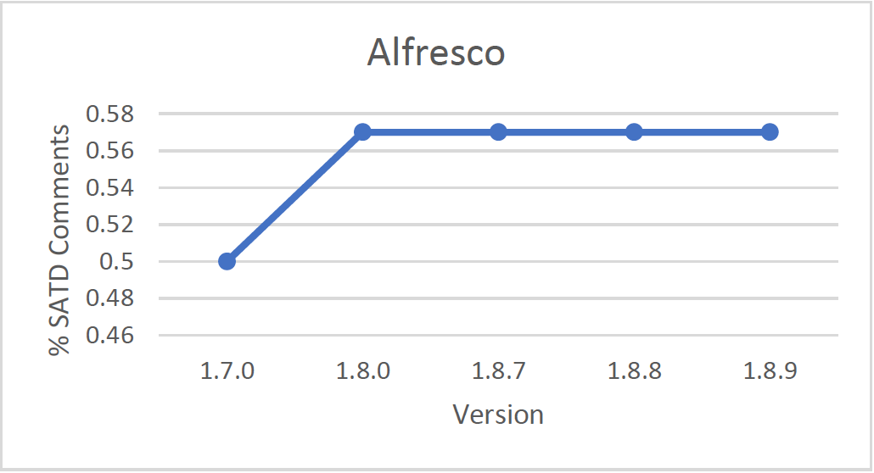
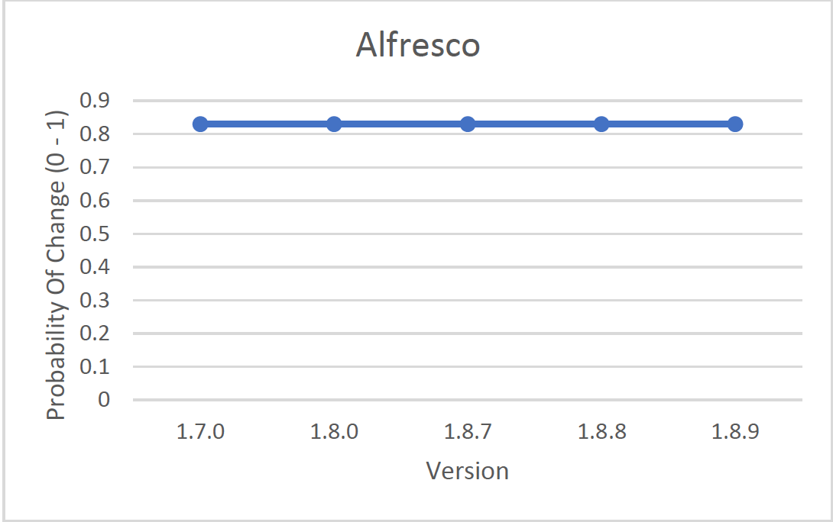
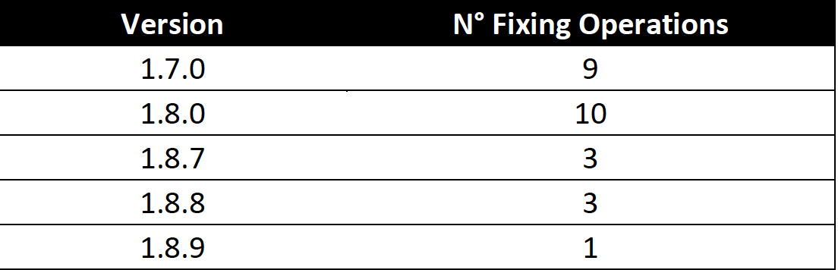
alfresco

Slide 23
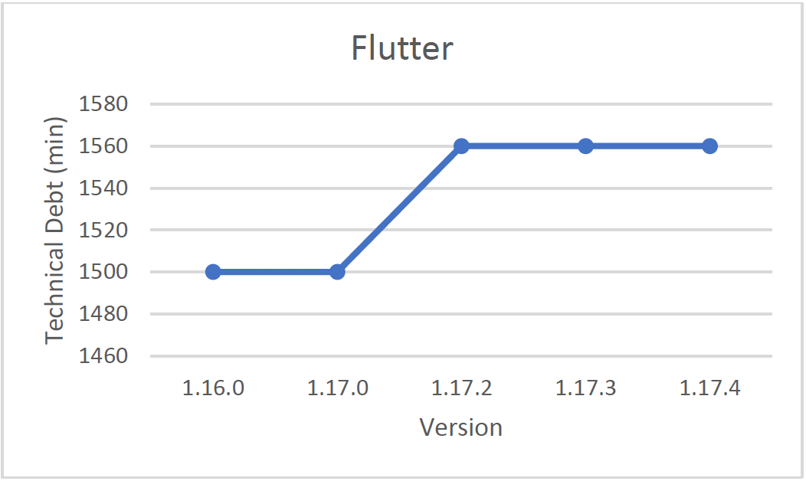
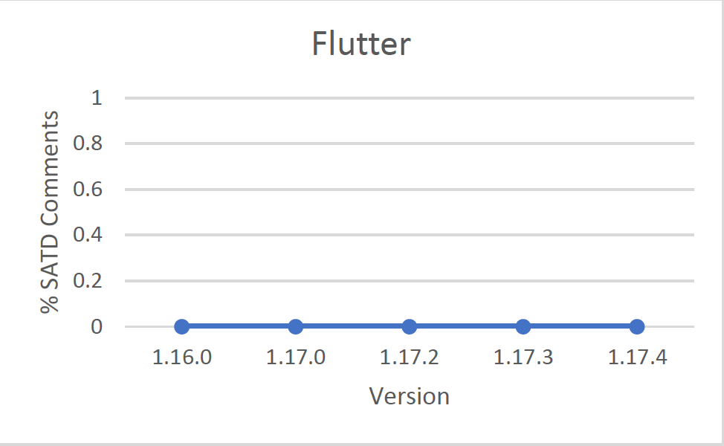
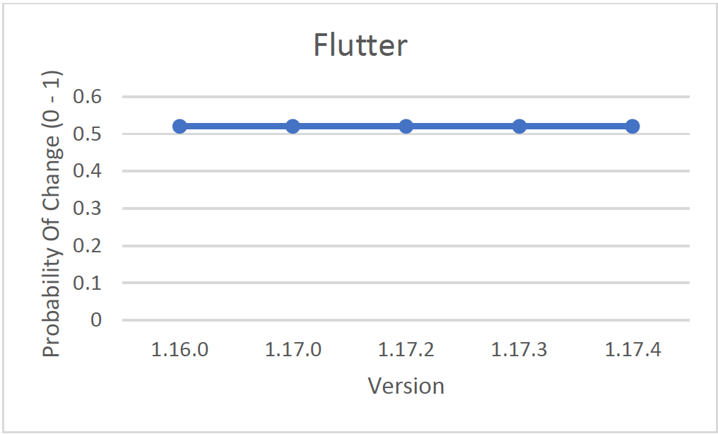
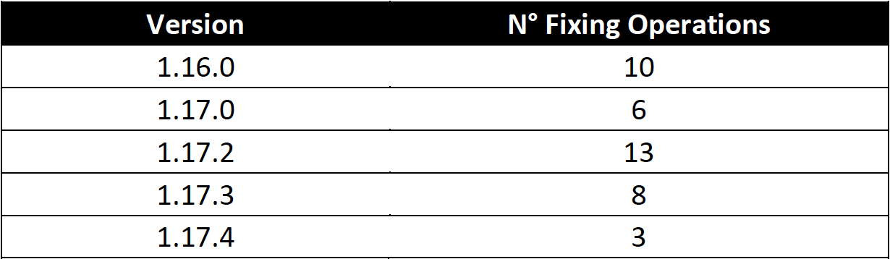
FLUTTER

Slide 24
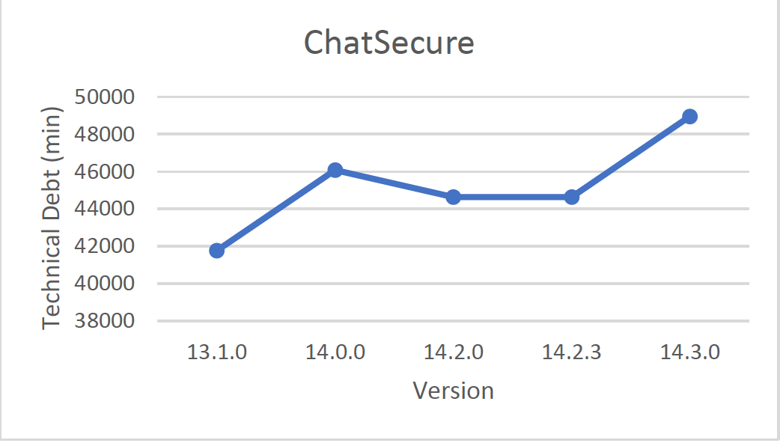
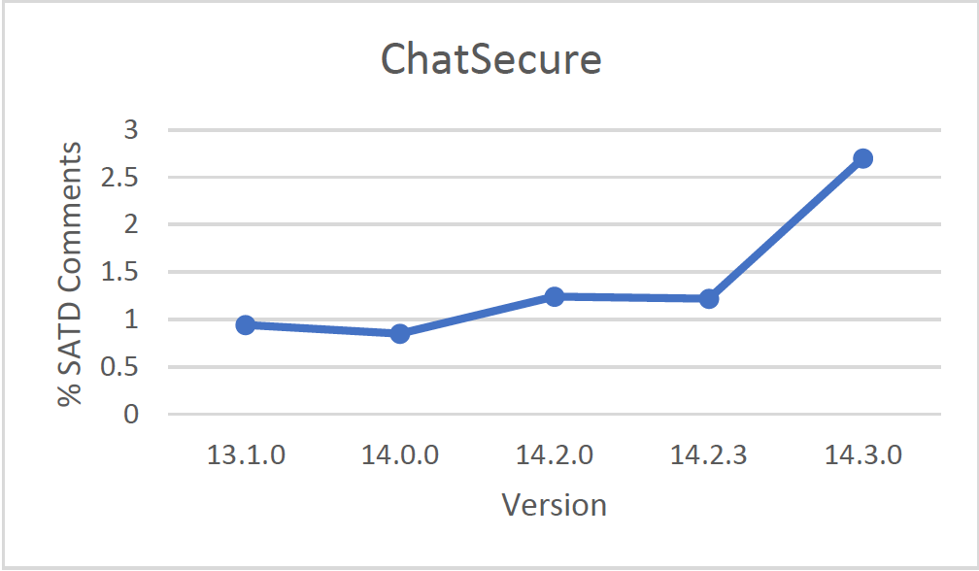
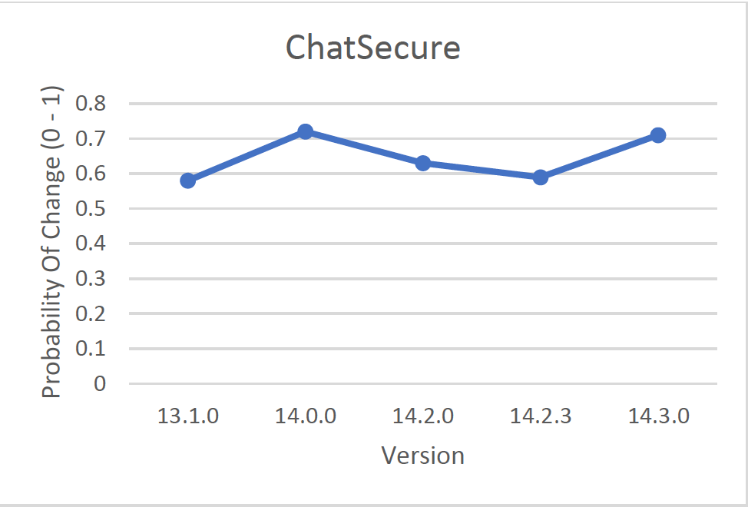
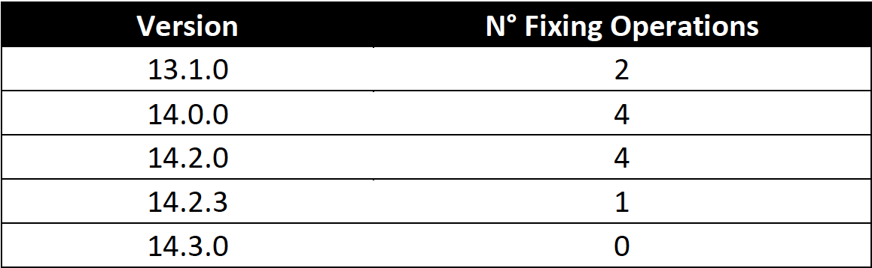
CHATSECURE

Slide 25
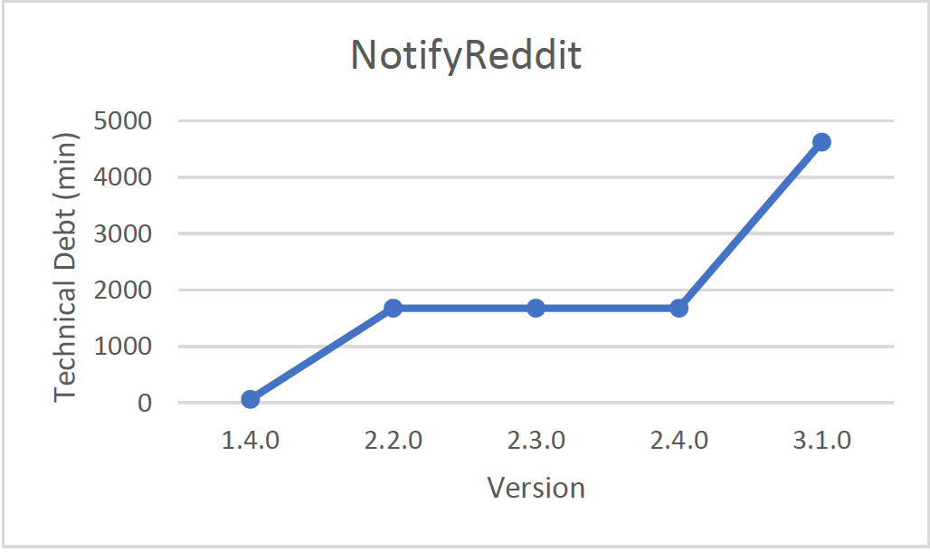
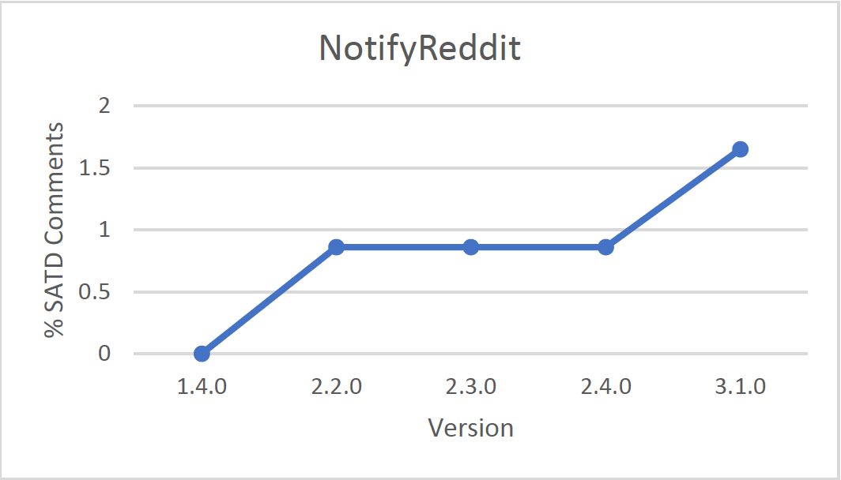
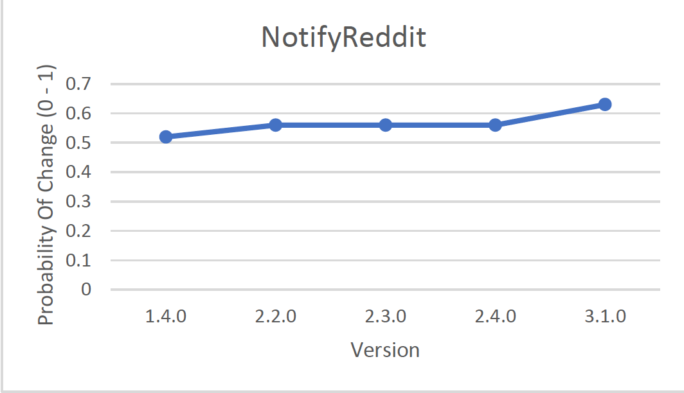
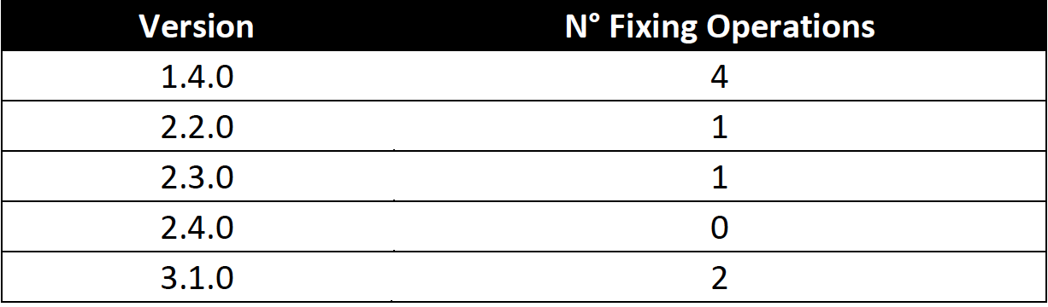
Notifyreddit

Slide 26
CONCLUSIONS AND FUTURE WORK
The term technical debt is being used for practitioners and researchers in the software engineer community to express shortcuts and workarounds employed in software projects. These shortcuts will most often impact the maintainability of the project hindering the development if not addressed properly.
My work explored specifically technical debt (also self-admitted technical debt) in the context of mobile application.
I find that the TD can decrease between versions due to refactoring operations (for example due to an extract class refactoring) or, in some cases, it can increase due to the addition of functionalities to the app or due to the increment of classes and LOCs between versions.
I find that the majority of the self-admitted technical debt comments are design debt. The % of SATD comments it’s quite high in all considered apps (>1%). Based on this result, we can say that the self-admitted technical debt types that developers admit to the most are related with the design of the project, potentially indicating that developers feel the need to admit and be forthcoming about such debt.

Slide 27
CONCLUSIONS AND FUTURE WORK
In all the apps considered the probability of change is quite high because it’s higher than 0.5. This means that the apps have the 50% to be changed in the future. Moreover, the TD seems not to impact on change proneness the, in some cases, it is even increased when the TD decreased.
In the projects analyzed, there weren't many fixing operations but, when they were, they do not seem to have contributed neither to the decrease nor to the increase of TD.
I hope that this work will encourage future research in the area of technical debt and self-admitted technical debt in the context of mobile application.
I also think that the information provided by this dataset can be a cornerstone for more advanced techniques as natural language processing.
In a future work I plan to improve the current analysis adding more projects to it. With a richer dataset I expect that more patterns and characteristics of technical debt and self-admitted technical will be retrieved.

Slide 28
REFERENCES
W. Cunningham. The WyCash portfolio management system. OOPS Messenger, 4(2):29{30, 1993.
A. Potdar and E. Shihab. An exploratory study on self-admitted technical debt. In Proceedings of the 2014 IEEE International Conference on Software Maintenance and Evolution, ICSME '14, pages 91{100, 2014.
Gabriele Bavota, Barbara Russo. A Large-Scale Empirical Study on Self-Admitted Technical Debt. 2016 IEEE/ACM 13th Working Conference on Mining Software Repositories
Everton da S. Maldonado and Emad Shihab. Detecting and Quantifying Different Types of Self- Admitted Technical Debt

Slide 29
(Self-admitted) Technical debt in mobile applications
SOFTWARE DEPENDABILITY PROJECT
Student:
Federico De Roma
Università degli Studi di Salerno f.deroma@studenti.unisa.it
External Advisor:
Gemma Catolino
Post-doctoral researcher at the Delft
University of Technology, NL
g.catolino@tudelft.nl

